Slide 1


CaBuCo
Project Information Session
12 January, 2026
5th Information Session
Peter Kiska

Slide 2

Overview
The overall objective of this coordination project is to assist EURAMET’s bodies to achieve impact for the European metrology community by coordinating and managing the capacity building by three instruments:
    Researcher Mobility Support (RMS)
    Mentoring Scheme Award (MSA)
    Training events (TE)
https://cabuco.cmi.gov.cz/

Slide 3

Project details
Lead institute: Czech Metrology Institute
Coordinator: Peter Kiska
Start date: 1st June, 2024
Duration: 48 months
Budget: 1 mil. EUR
Full name: Capacity Building Coordination
Akronym: CaBuCo
Project number: 23CBC01

Slide 4

CALL OPEN
The CaBuCo project will be executed through three open calls a year.
Call 4 OPEN – October 1, 2025 – January 31, 2026
Deadlines of the calls 3x per year: 31 January – 31 May – 30 September 2026
Last Call Q3 2027.
First activities in Call 4 funded by the project will be implemented from
mid April, 2025 at the earliest.

Slide 5
Research Mobility Support (RMS)
This instrument supports researchers from EURAMET NMIs and DIs to join an organisation in a different country to their employer (a EURAMET NMI or DI or other institution that can host suitable research).
Applicants: EURAMET NMIs/DIs and NMIs/DIs from EU member states and countries associated to Horizon Europe.
Host Organisation: EURAMET NMIs/DIs and other institutions (e.g., universities, public research organisations), that are or have been participating in Partnership JRPs and located in different country.
1-9 months, interruption is possible,
Only 1 researcher from the employing organization
Financial allowances:
• Living allowance of €2400 (plus a country correction factor) per month to cover accommodation, subsistence, and local travel.
• Travel – a fixed allowance of €500 paid every 3 months.
• Development – maximum amount of €1000 can be used for conference attendance (during the lifetime of the RMS).

Slide 6
Research Mobility Support (RMS)
Funds: the employing organisation receive the funds.
Payment: Pre financing 80%, final payment 20% (60 days after approval of final report)
Typical activities:
Must include research and/or development.
Add value to an associated JRP; and is suitably scientifically and/or technologically challenging.
Include scientific training and transfer of knowledge.
Implement new or improved measurement tools/artefacts.
RMS application must be submitted via the project web platform.
Link to the application - RMS

Slide 7
Mentoring Scheme Award (MSA)
MSA provides a platform for up to 6 participants from two different metrological institutes (EURAMET NMI or DI), in different countries, to set up a partnership and work together on a relevant topic, such as technical, managerial, comparisons or traceability.
Applicant: EURAMET NMIs/Dis and NMIs/DIs from EU member states, countries associated to Horizon Europe.
Host Organisation: EURAMET NMIs/DIs and NMIs/DIs from EU member states and countries associated to Horizon Europe.
Duration: 2-6 person/weeks, not necessarily consecutively, at the partner organisation which is in a different country to their employing organisation.
Financial allowances: project will reimburse actual costs incurred for travel, accommodation and subsistence for MSA recipients for their visit(s) to the counterpart organisation according to the accounting rules of their Employing organisation (financial estimates need to be send within application)
Typical activities: Support exchange of expertise on technical topics, managerial topics;
!! MSA participants must remain employed by their current employing organisations for the scheme’s duration !!

Slide 8
Training events
(Trainings, Workshops and Summer Schools)
For EURAMET to maintain and further expand its capacity building efforts across Europe. Within this activity, project develop the technical skills of existing staff at NMIs/DIs, support the development of newly qualified staff for all EURAMET NMIs/DIs and prepare them for work in a metrological laboratory.
Applicants: EURAMET NMIs/Dis.
Participants: Staff members of EURAMET NMIs and DIs, students, representatives of RMOs.
- Minimum number of participants per event is 5.
- Minimum number of participating countries is 3.
Duration:
- Training courses and workshops to be held as 1–5 days events.
- Summer Schools held as 3-10 days events.
Typical activities: Training events would cover several topics that are relevant to NMI and DIs. Typical topics would be prioritised and decided on annually by EURAMET bodies.
Financial allowance: project will reimburse the actual costs incurred for travel and subsistence of key speakers, venue hire (if required) and catering costs according to the accounting rules of the hosting organisation.
The salaries of speakers and organising institution is not covered by the CaBuCo.

Slide 9
One-year Overview of Funded Proposals

Slide 10
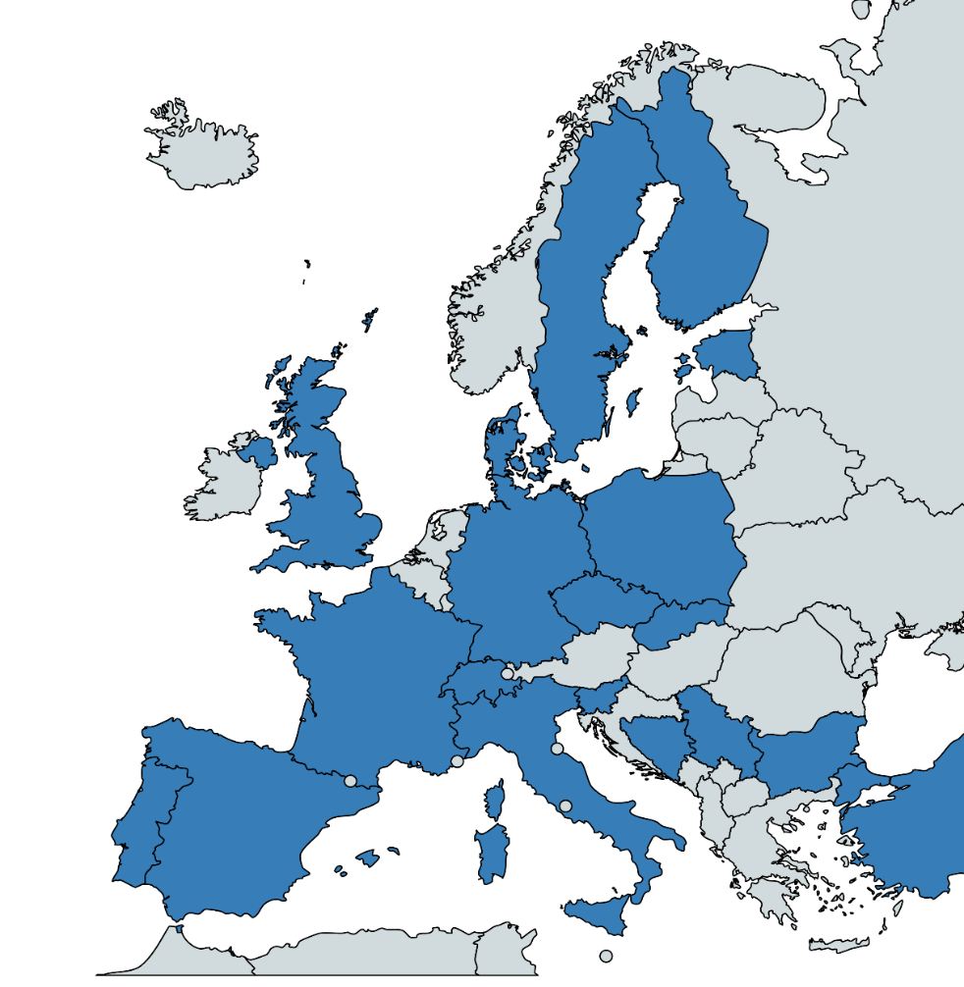
Overview of participating countries
Bosnia and Herzegovina (IMBiH)
Bulgaria (BIM)
Czech Republic (CMI)
Denmark (DFM)
Estonia (Metrosert)
Finland (STUK, MIKES)
France (LNE, CNAM)
Germany (PTB)
Italy (INRiM)
Polland (GUM, INTiBS)
Portugal (IPQ)
Serbia (VINS)
Slovakia (SMU)
Slovenia (Uni Ljubljana)
Spain (CEM, INTA)
Sweden (RISE)
Switzerland (METAS)
Turkey (TUBITAK)
United Kingdom (NPL)

Slide 11

Q&A ???
Send me your questions on email: peter.kiska@cmi.gov.cz

Slide 12


Thank you for your attention!

